Slide 1
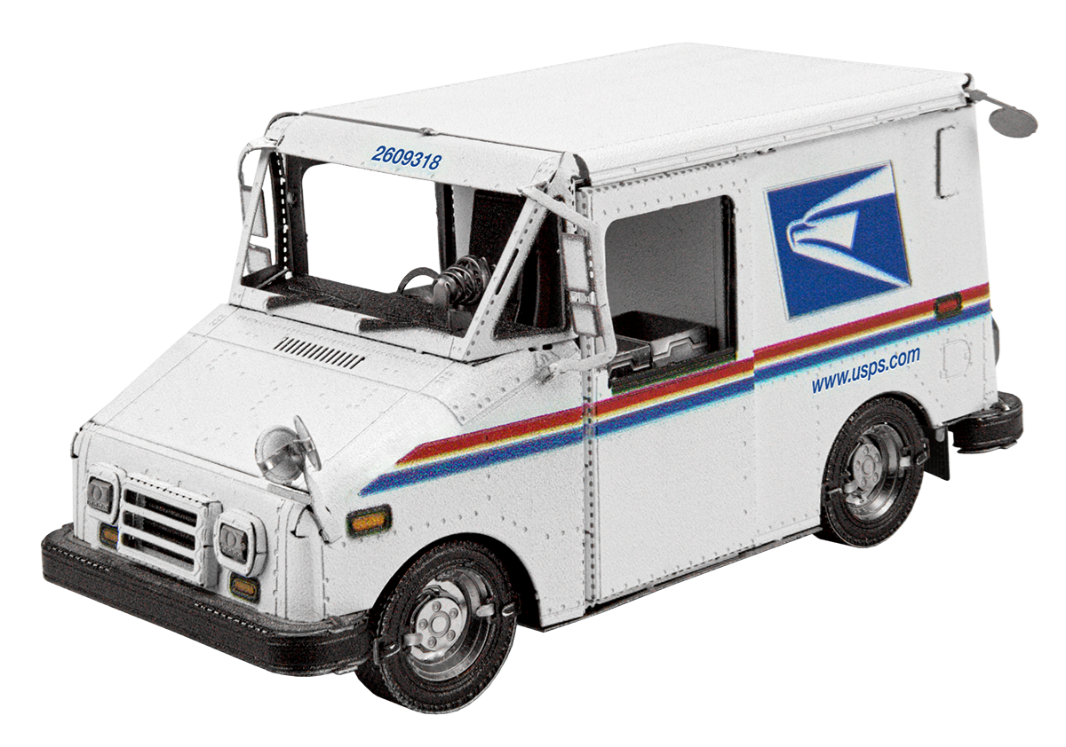
Capstone Project
ESP32 Mail Alert System
By Carson Alberding -- Computer Science Pathway

Slide 2
Introduction
Hardware development based
Initially planned for research project
Breadboarding / circuit design
Worked with UD Computer Engineering professor Dr. Richard Martin
Shifted project focus

Slide 3
Problem & Initial Goals
Build some kind of device that detects when the mail comes
Audible/digital notification system
Attempted very briefly in the past with Raspberry Pi
Decided to take a different approach with the ESP32
Build a reliable and sustainable solution
Solar powered

Slide 4
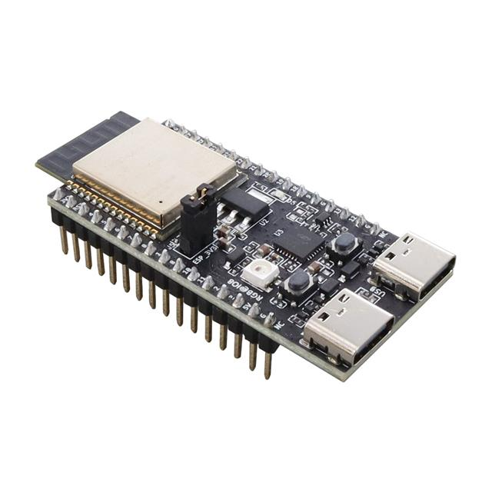
ESP32
Low-cost & low power WiFi-enabled microcontrollers
Programmable through Arduino IDE (C++)
Sensor control through GPIO pins
Can be easily powered by batteries or USB
Good fit for the project

Slide 5
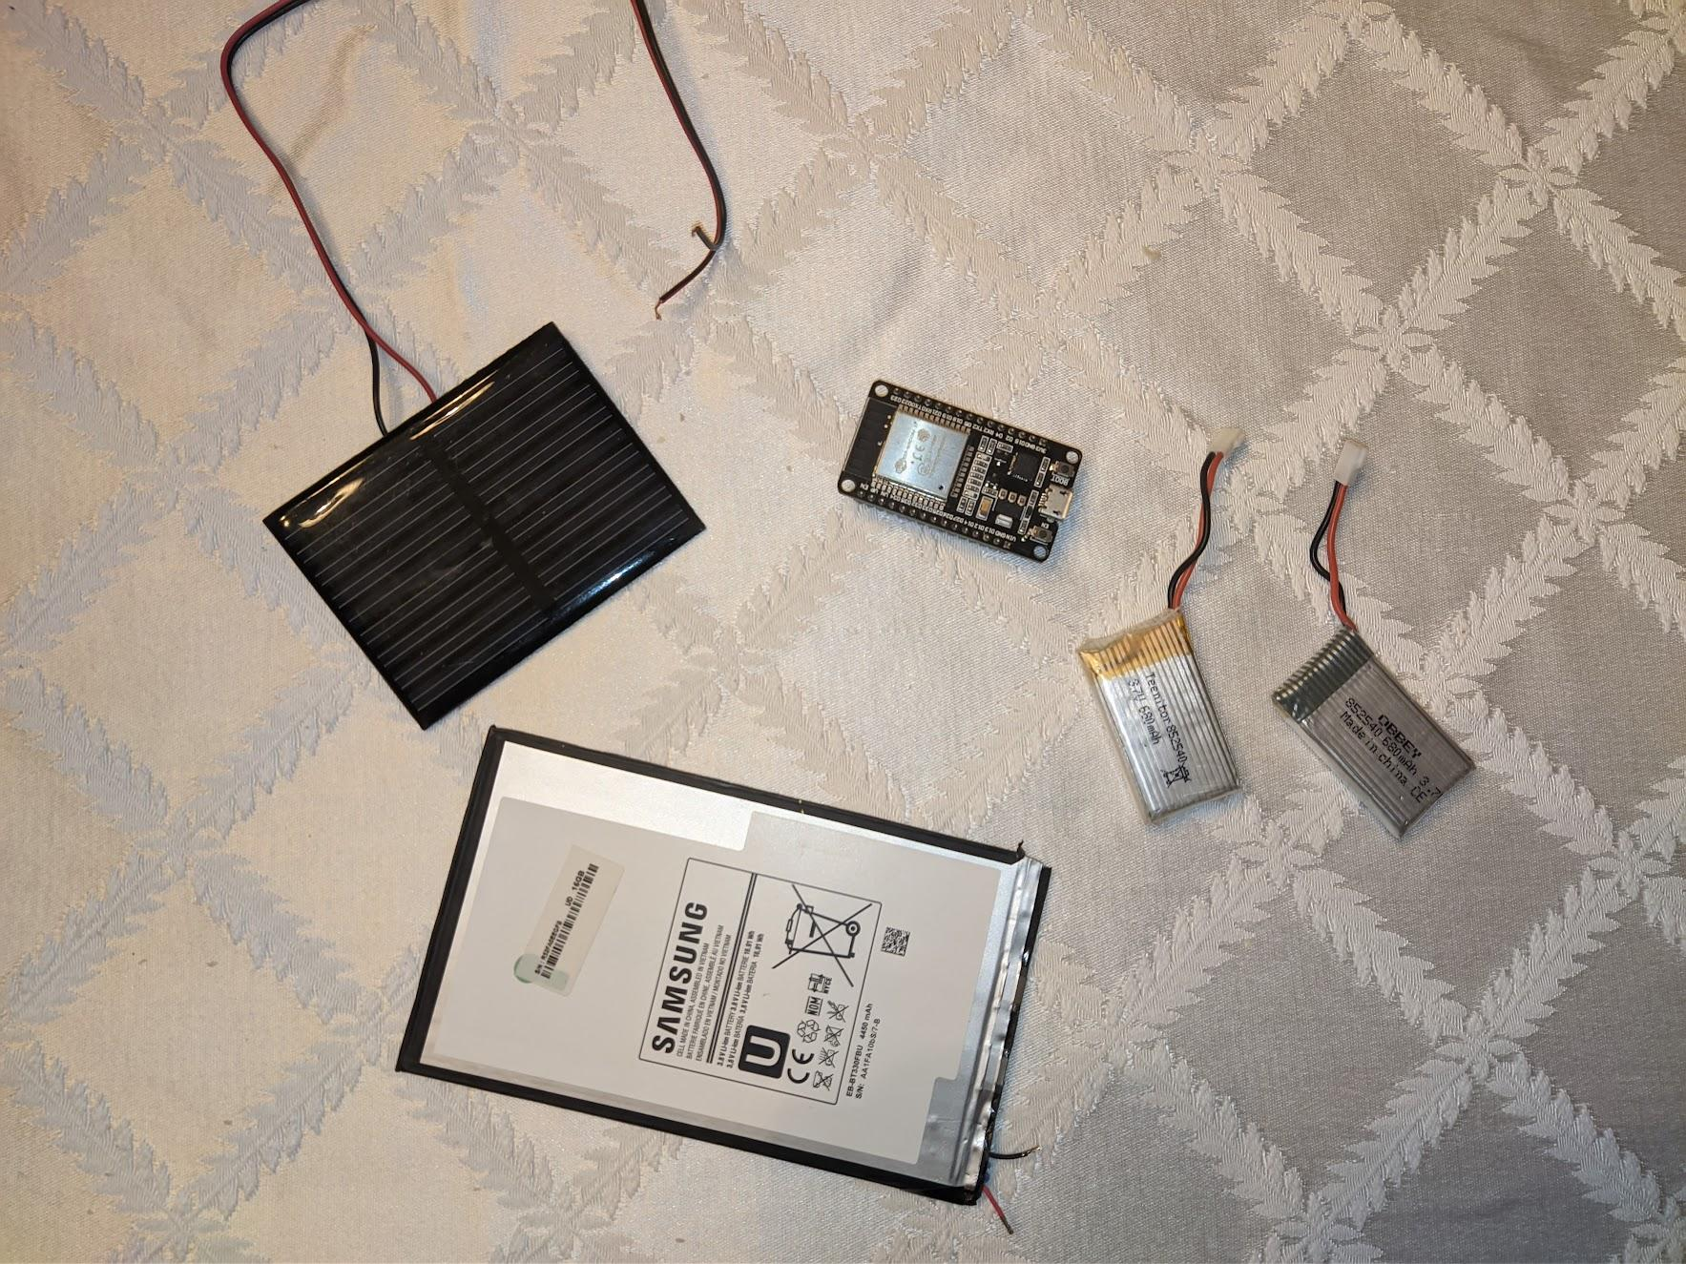
Materials
ESP32 dev board
Soldering stuff
Photoresistor
Wire
Battery
Multimeter
Solar Panel
Charging regulator
Voltage regulator
Raspberry Pi
Bluetooth Speaker

Slide 6
Problem 1: WiFi
Needed to test whether the WiFi strength in the mailbox was sufficient
Using Arduino IDE, coded simple wifi strength program (Magdy, n.d.)
Connected the ESP32 to laptop through USB to display results
Very poor wifi connection
Able to maintain connection (possibly?) but not establish a new one
Workable signal -30dBm to -85dBm
Results were in the -90dBm range
Moving the router didn’t help
Making an antenna didn’t help
A lot of trial and error overall

Slide 7
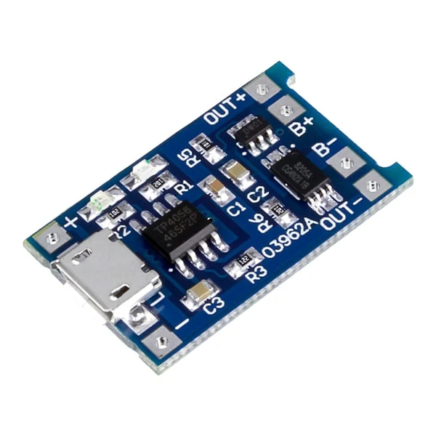
Problem 2: Power
Initially planned to use 700mAh 3.7v drone battery
Planned to use solar power to charge the battery
Bought TP4056 charging regulator (Power ESP32, n.d.)
Bought MCP1700 voltage regulator
Planned to use a feature called deep sleep on ESP32 (“Sleep,” n.d.)
Active from 12:00 - 4:30 PM each day, sleep for the rest
Online sources stated that the ESP32 I had used <<1mA during deep sleep
Actually was about a 10mA draw in deep sleep
Assuming battery is at maximum capacity, it would likely die in the span of 2 cloudy days
Low quality solar panel did not produce any substantial output with indirect sunlight

Slide 8
Fixing Issues
Decided that a new ESP32 board was needed to potentially fix these issues
After a bit of research, I decided to get the much newer ESP32-c6 (“ESP32-C6,” n.d.)
Hoping that it resulted in improved wifi strength and lower sleep power consumption
Didn’t want to bank on the lower power consumption, so I bought better solar panels
Tried to test if charging was working each day that I could
Putting 2 solar panels in parallel would double the current output
When I got the new ESP32, I measured <0.1mA current when sleeping
When it was on, current was between 30-40 mA and ~10mA less when wifi was off
WiFi seemed to be better as well inside the house, with a 10dBm increase in signal
Critical problems seemed to be fixed -- for now

Slide 9
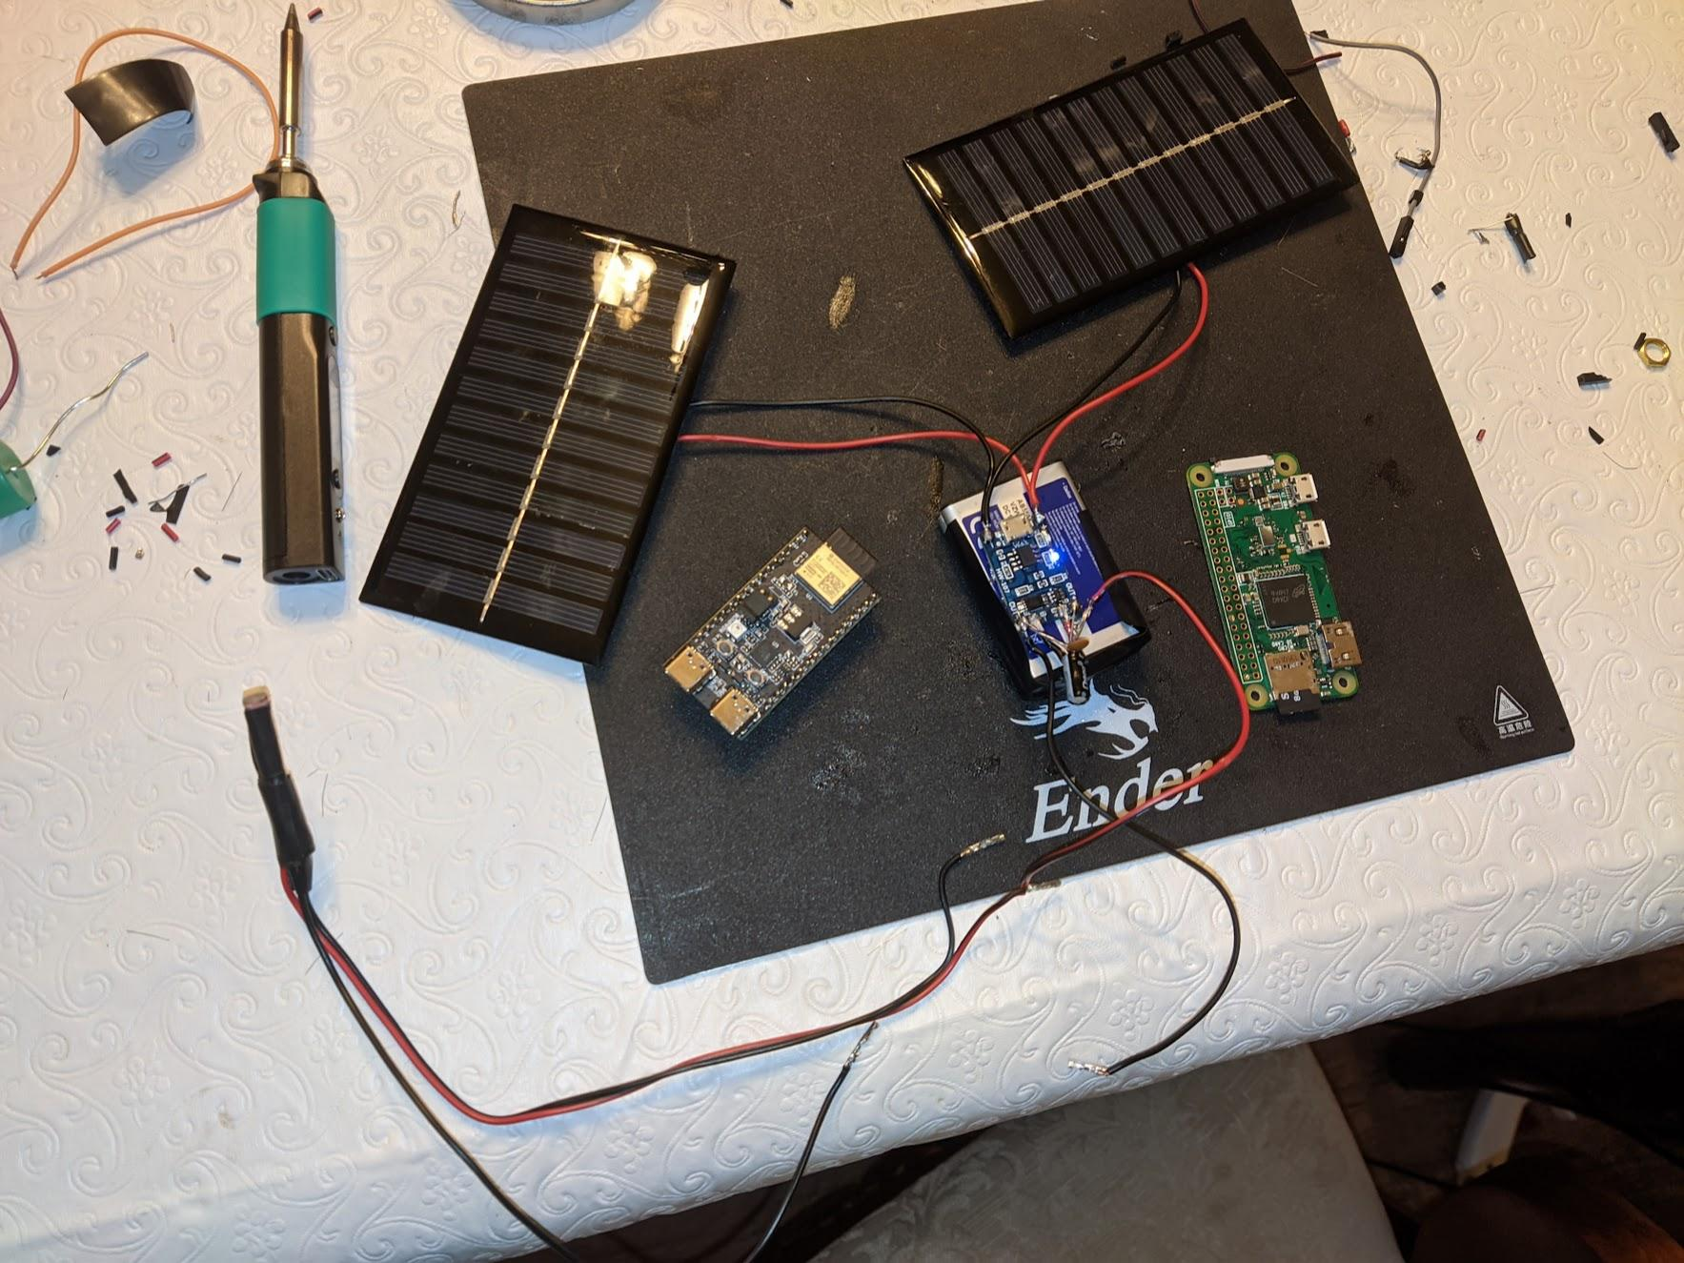
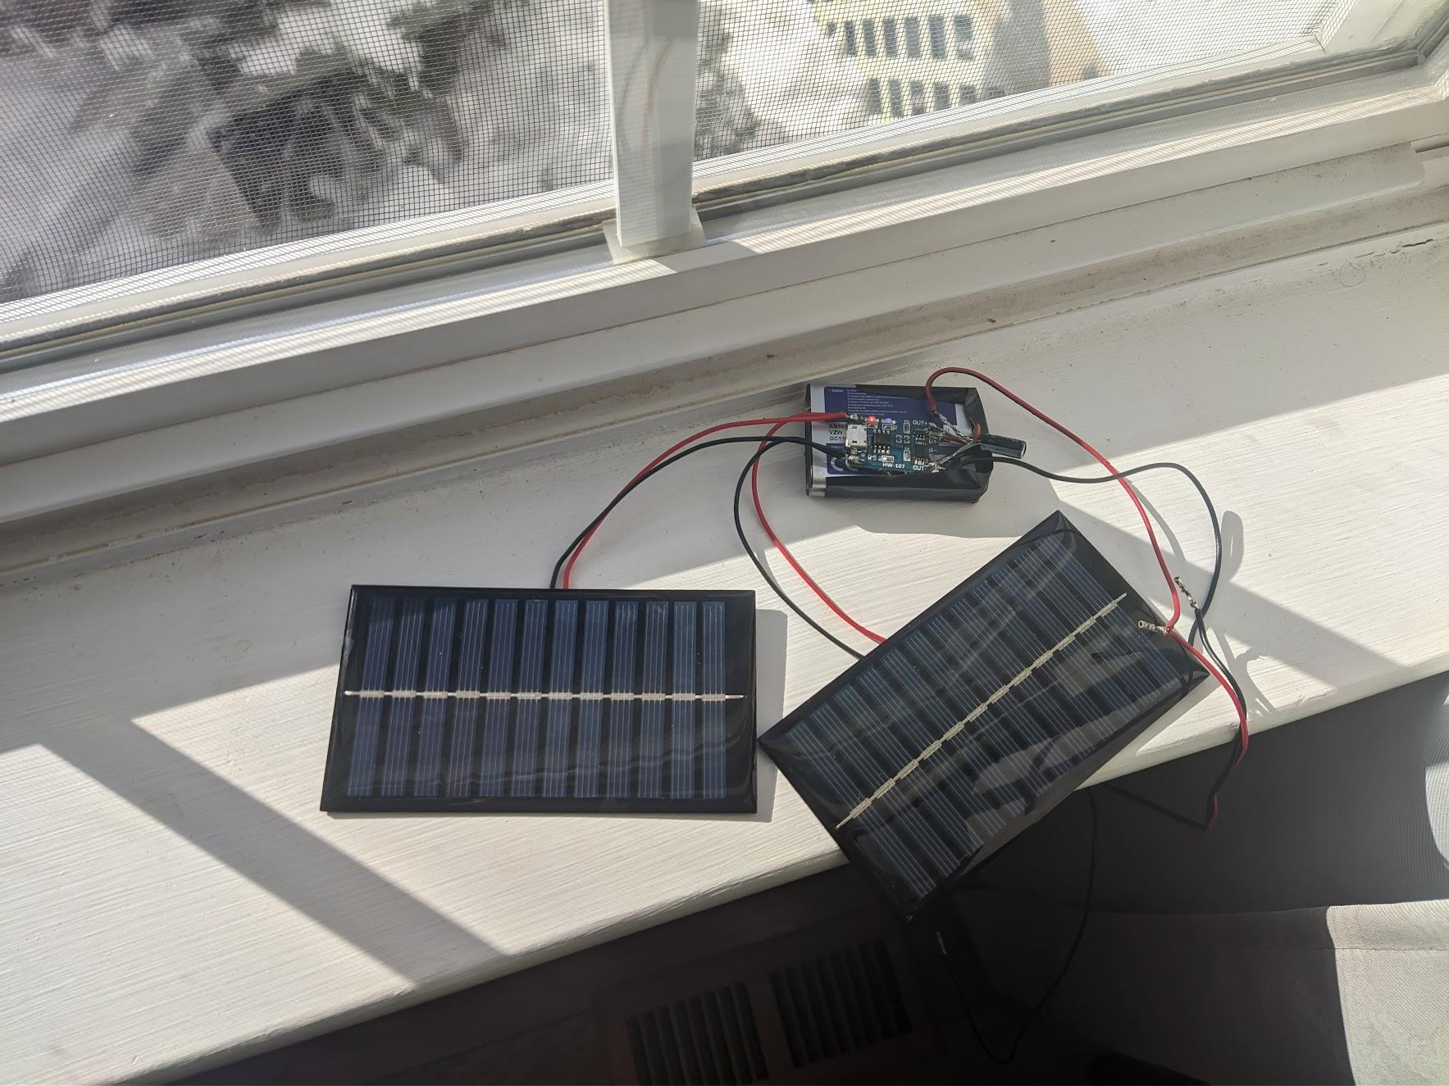
Charging Setup

Slide 10
Coding
With most of the hardware issues figured out, it was time to start coding the actual software
Planned to use a photoresistor as the sensor, so one of the GPIO pins on the ESP32 could read it
Needed to design the code around the fact that deep sleep reruns the code from the beginning
Designed to be ran at any time of day or night
Reduce power consumption by limiting its active hours and WiFi usage

Slide 11
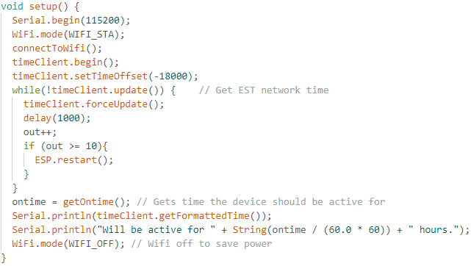
Code Overview: Setup Method

Slide 12
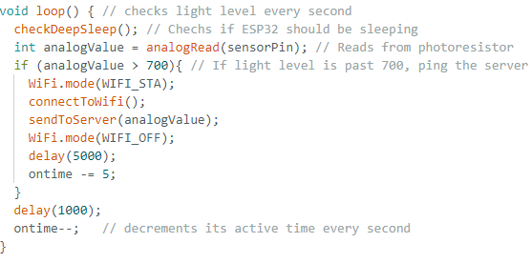
Code Overview: Loop Method

Slide 13
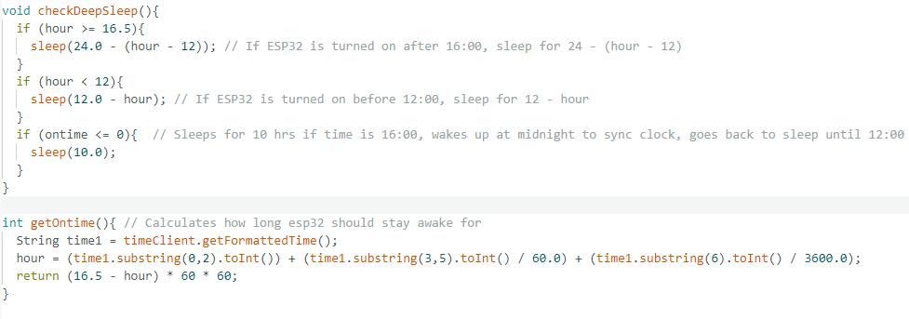
Code Overview: Time methods

Slide 14
Mounting the Device
Inside the Mailbox
Outside the Mailbox
Pros No waterproofing Concealed | Cons Poor WiFi connection Takes up space Build a hidden setup
Pros Reliable WiFi Easier wiring setup | Cons Waterproofing Hard to access components Finite space Looks ugly

Slide 15
Optimal Solution
Since the mailbox post it sat on was vinyl, I figured it must be hollow inside
Prying it open revealed a large, hollow space for all the electronics
No weatherproofing required
Plastic interior resulted in a reliable WiFi connection
Drilled a small hole for wires to pass through
Mounted 2 solar panels with strong double faced tape S & E facing
Routed the photoresistor setup though a small hole in the back corner of the mailbox
Covered all wires and openings with white tape
Ensured that the ESP32 was in an accessible location

Slide 16
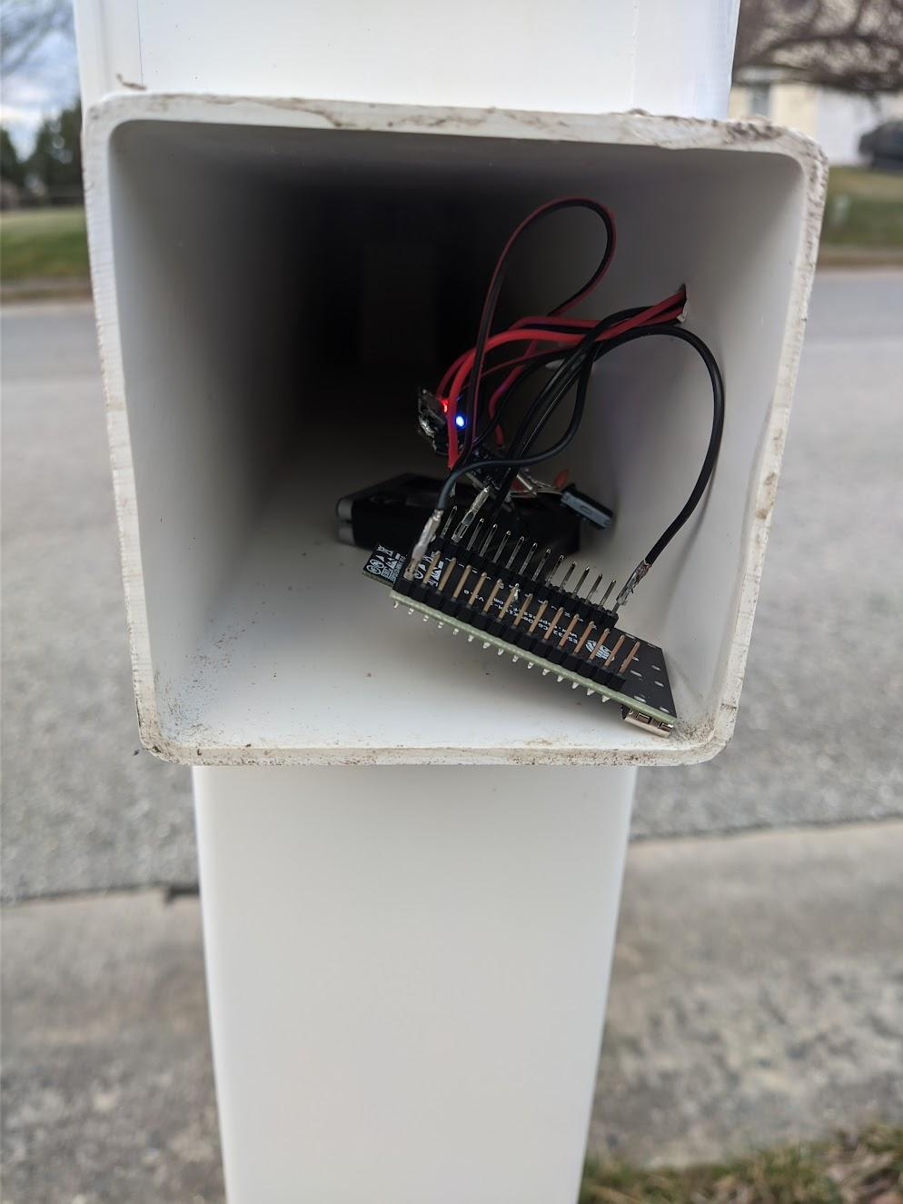
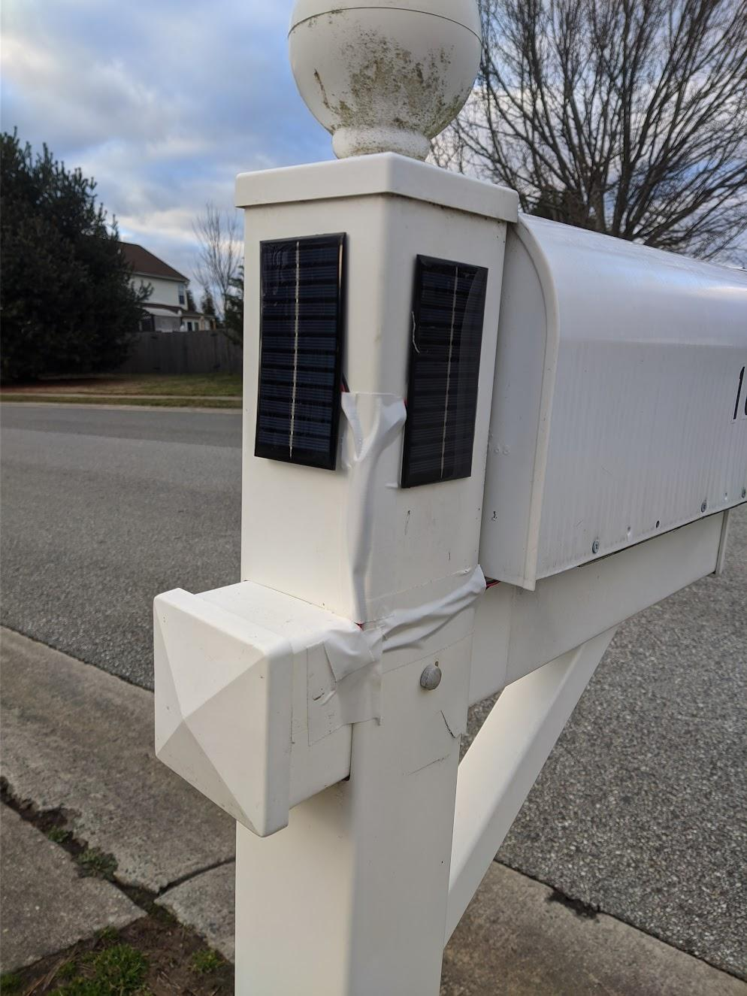

Slide 17
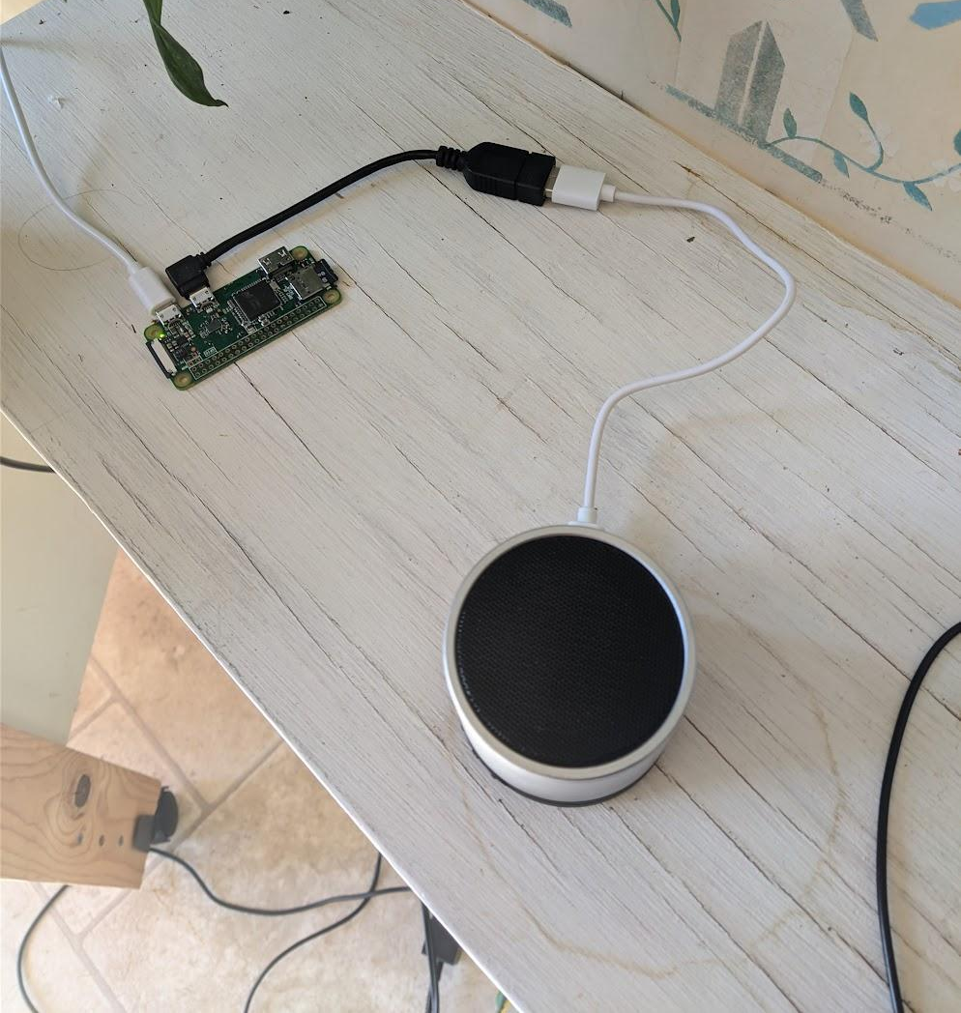
Server Setup
NodeJs would be easy enough to set up and has a bunch of libraries and support
Decided to go with the Raspberry Pi zero to run the server
Server will be constantly listening for anything sent to it
Was able to connect with a bluetooth speaker to play the sound
Created a linux service to pair with speaker on boot
Used PM2 to automatically start the server on boot (“Running Node”, 2023)

Slide 18
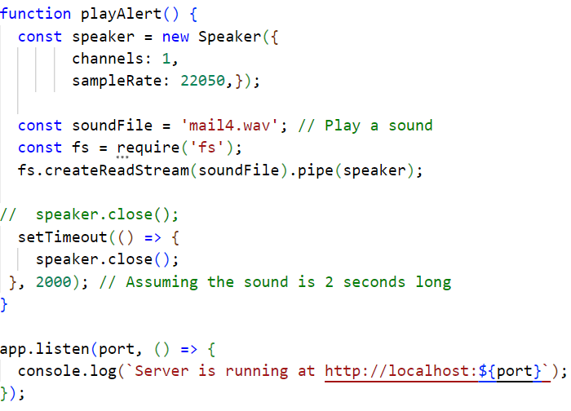
Server Code

Slide 19
Initial Results
The device worked, but only some of the time
I would open the mailbox 4 times to test it, but the notification would only sound twice
It would stop functioning after a day or two and had to manually reset
It seemed like the device was freezing somehow
The battery and solar setup was working great; no power issues

Slide 20
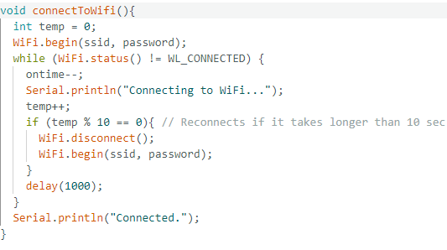
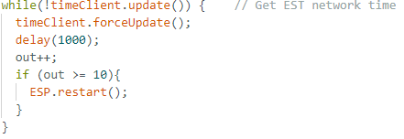
Debugging
Trying to figure out what was wrong over the next few weeks
Hard to iterate on since I would have to wait long periods of time
It was clear that it would stop functioning after a sleep cycle
Was working fine when I reset it during the day
I changed the variable type for the amount of time it sleeps for
Added a timeout for connecting to wifi and fetching the network time
Changed the format of the audio file it played so it worked every time

Slide 21
Reflection
Overall, the project was a success
Developed a working prototype that functioned as intended
A lot more involved than I originally thought
Many little issues added up
Good learning experience
Glad I was able to make something actually helpful
Appreciate the guidance given by my mentor

Slide 22
Resources
Power ESP32/ESP8266 with Solar Panels and Battery. (n.d.). Random Nerd Tutorials. Retrieved April 6, 2024, from https://randomnerdtutorials.com/power-esp32-esp8266-solar-panels-battery-level-monitoring/
Sleep Modes - ESP32-C6 - — ESP-IDF Programming Guide v5.2.1 documentation. (n.d.). Technical Documents. Retrieved April 6, 2024, from https://docs.espressif.com/projects/esp-idf/en/stable/esp32c6/api-reference/system/sleep_modes.html
Magdy, K. (n.d.). Get ESP32 WiFi Signal Strength (Arduino) & RSSI Value. DeepBlue. Retrieved April 6, 2024, from https://deepbluembedded.com/esp32-wifi-signal-strength-arduino-rssi/
ESP32 HTTP GET and HTTP POST with Arduino IDE. (n.d.). Random Nerd Tutorials. Retrieved April 6, 2024, from https://randomnerdtutorials.com/esp32-http-get-post-arduino/
Running Node.js Apps with PM2 (Complete Guide). (2023, October 25). Better Stack. Retrieved April 9, 2024, from https://betterstack.com/community/guides/scaling-nodejs/pm2-guide/
ESP32-C6 Wi-Fi 6 & BLE 5 & Thread/Zigbee SoC. (n.d.). Espressif Systems. Retrieved April 10, 2024, from https://www.espressif.com/en/products/socs/esp32-c6

